Slide 1


Bibliography Analysis: Un Tutorial Metodológico para hacer Comparaciones Estadísticas con Tests No Paramétricos en Propuestas de Minería de Datos
Eduardo Destefani Stefanato¹*
Vitor Souza Premoli Pinto de Oliveira¹*
¹Universidade Federal do Espírito Santo
Artificial Intelligence Applied to Images
Universidade Federal do Espírito Santo
Artificial Intelligence Applied to Images
Deep ANNs applied to images

Slide 2
Intoduction
Sumary
OBJECTIVES;
ARTICLE;
Introduction;
Objectives and methodology.
TESTS;
Friedman;
Multiples Signs;
Aligned Friedman;
Quade.
CONCLUSION;
Income differences.
REFERENCES.
Universidade Federal do Espírito Santo
Artificial Intelligence Applied to Images
Deep ANNs applied to images

Slide 3
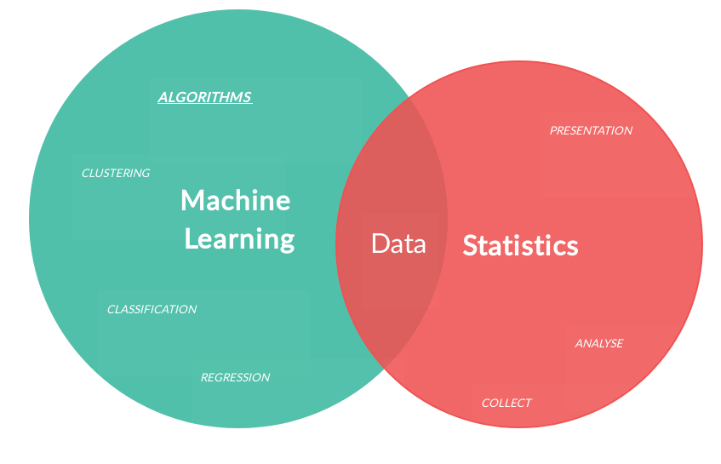
Introduction
Data Mining
Objectives
Article: Un Tutorial Metodológico para hacer Comparaciones Estadísticas con Tests No Paramétricos en Propuestas de Minería de Datos:
Objective;
Methodology;
Tests.
Results;
Conclusion.
Guide to Statistical Hypothesis Tests in Python. Fonte: https://www.kaggle.com/shashwatwork/guide-to-statistical-hypothesis-tests-in-python
Universidade Federal do Espírito Santo
Artificial Intelligence Applied to Images
Deep ANNs applied to images

Slide 4
ARTICLE
Introduction
Universidade Federal do Espírito Santo
Artificial Intelligence Applied to Images
Deep ANNs applied to images

Slide 5
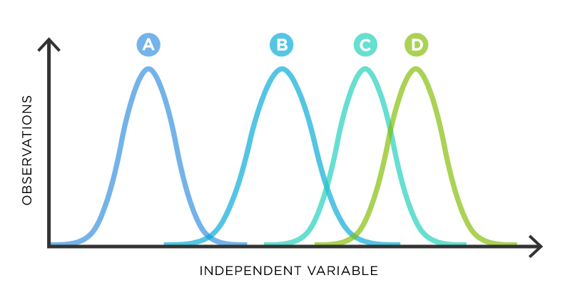
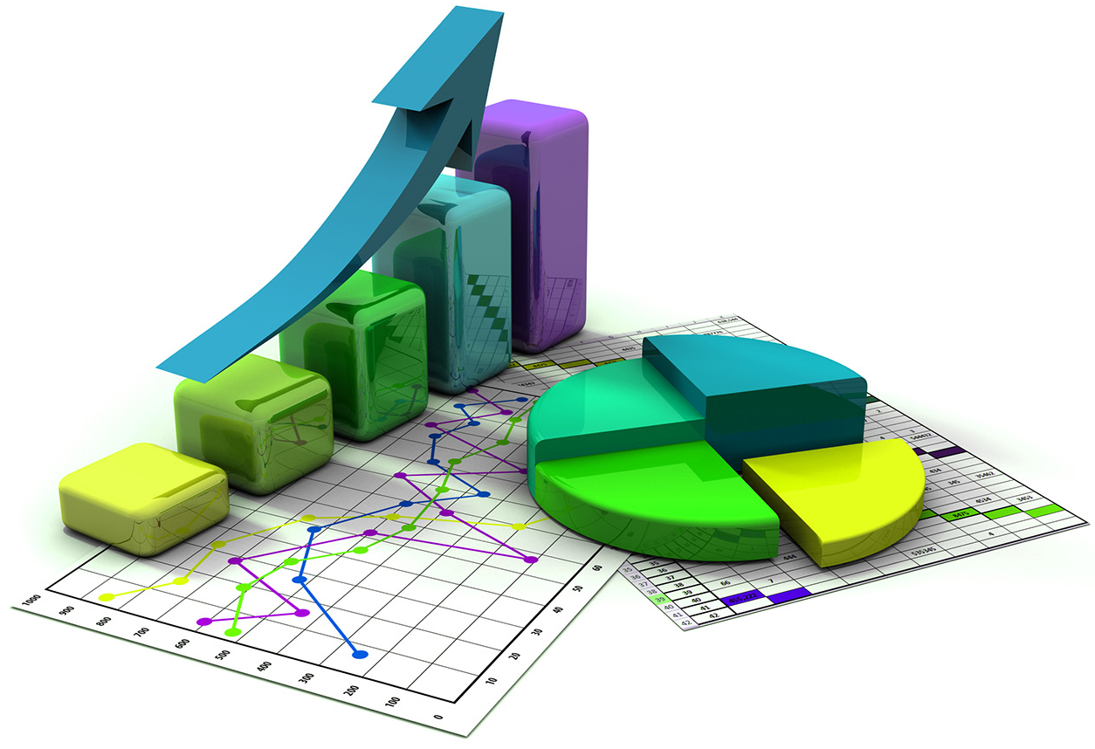
Article
Introduction
Data Mining
In data mining, it is necessary to conduct experimental analyses that allow us to verify when a technique behaves better than another than another on a given problem [1]. Then, The article aims to list all the statistical techniques that can be used in data analysis involving multi-class databases.
Universidade Federal do Espírito Santo
Artificial Intelligence Applied to Images
Deep ANNs applied to images

Slide 6
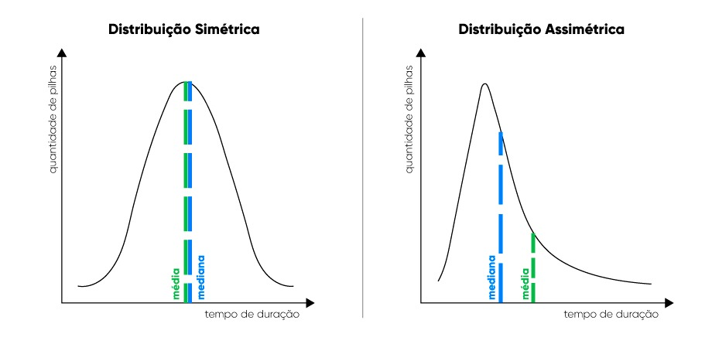
Article
Introduction
Parametrics and no Parametrics tests
Statistical tests can be parametric or nonparametric depending on the type of data they work with [2]. The first ones work with numerical values and are sensitive to outliers and assumptions of independence, normality and homoscedasticity in the sample of results, while the latter operate with ordinal values (rankings) and are more flexible than the former in the type of results to which they can be applied [1].
Use Parametric test
If data is normally distributed
Sample size more than 30
Use Nonparametric test
If data isn’t normally distributed
Sample size less than 30
Universidade Federal do Espírito Santo
Artificial Intelligence Applied to Images
Deep ANNs applied to images

Slide 7
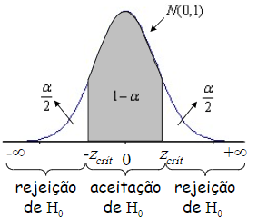
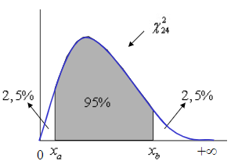
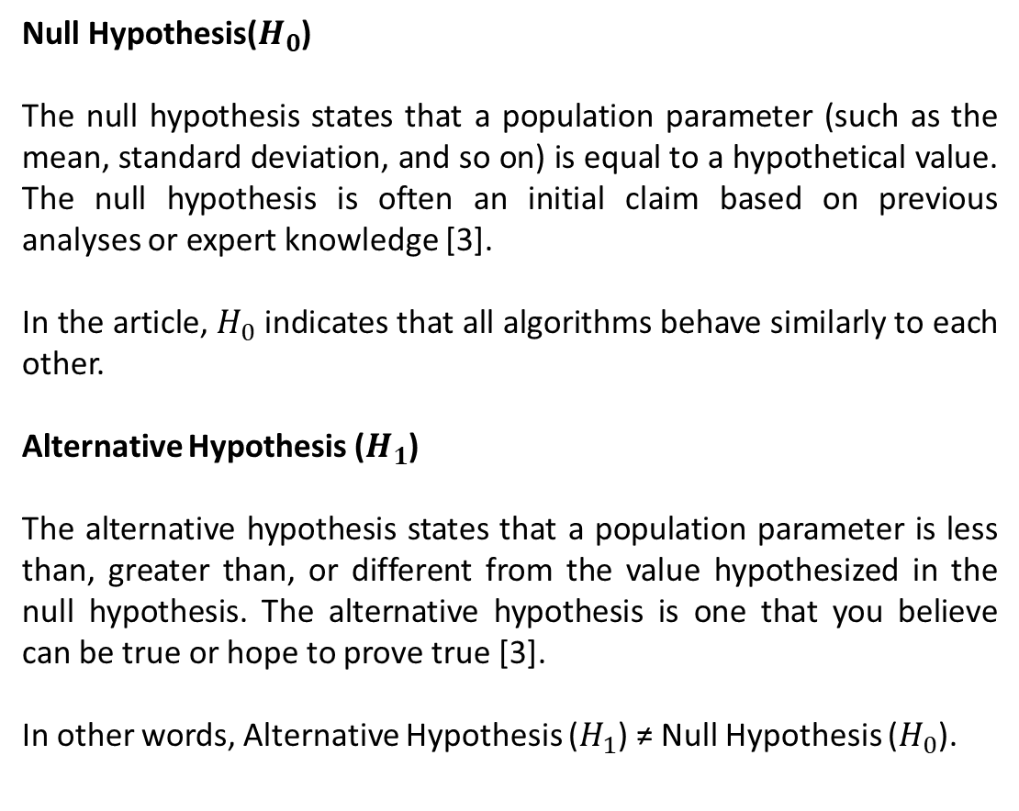
Article
Introduction
Statistical Conceptions
Null Hypothesis($H_{0}$)
The null hypothesis states that a population parameter (such as the mean, standard deviation, and so on) is equal to a hypothetical value. The null hypothesis is often an initial claim based on previous analyses or expert knowledge [3].
In the article, $H_{0}$ indicates that all algorithms behave similarly to each other.
Alternative Hypothesis ($H_{1}$)
The alternative hypothesis states that a population parameter is less than, greater than, or different from the value hypothesized in the null hypothesis. The alternative hypothesis is one that you believe can be true or hope to prove true [3].
In other words, Alternative Hypothesis ($H_{1}$) ≠ Null Hypothesis ($H_{0}$).
p-value
Universidade Federal do Espírito Santo
Artificial Intelligence Applied to Images
Deep ANNs applied to images

Slide 8
Article
Objectives
Objectives and methodology of research
Objectives:
List all the non-parametric statistical techniques that can be used in such comparisons;
Also, provide guidelines on the use of these techniques and give practical examples of their use.
Methodolgy:
For the classification problem, 24 data sets were used;
They used cross-validation on 10 folds, and the average results obtained the results obtained correspond to the percentage of test success in 3 runs of each algorithm.
Universidade Federal do Espírito Santo
Artificial Intelligence Applied to Images
Deep ANNs applied to images

Slide 9
TESTS
Development
Universidade Federal do Espírito Santo
Artificial Intelligence Applied to Images
Deep ANNs applied to images

Slide 10
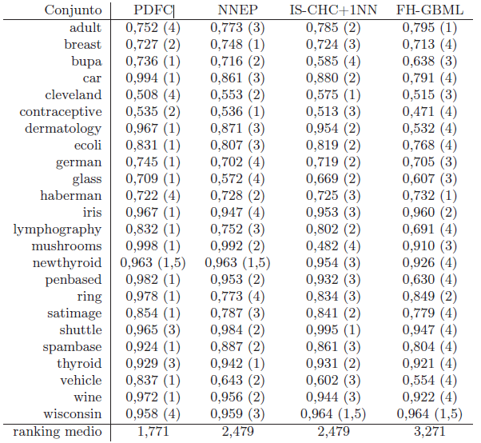
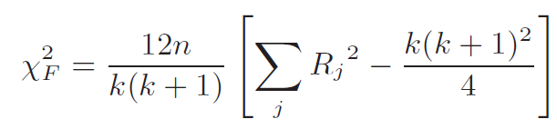
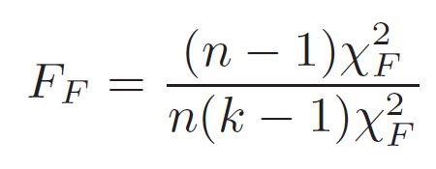
Tests
Development
Friedman
Table 1: Example of the use of the Friedman test. The rankings in parentheses are used in the calculation of the statistic
Test to determine the ranking of the algorithms applied to the databases:
The domain of the function is limited to "k -1" degrees of freedom. Where “k” is the number of algorithms [1].
Iman and Davenport. Where (k-1)(n-1) degrees of freedom, where n is the number of datasets:
Universidade Federal do Espírito Santo
Artificial Intelligence Applied to Images
Deep ANNs applied to images

Slide 11
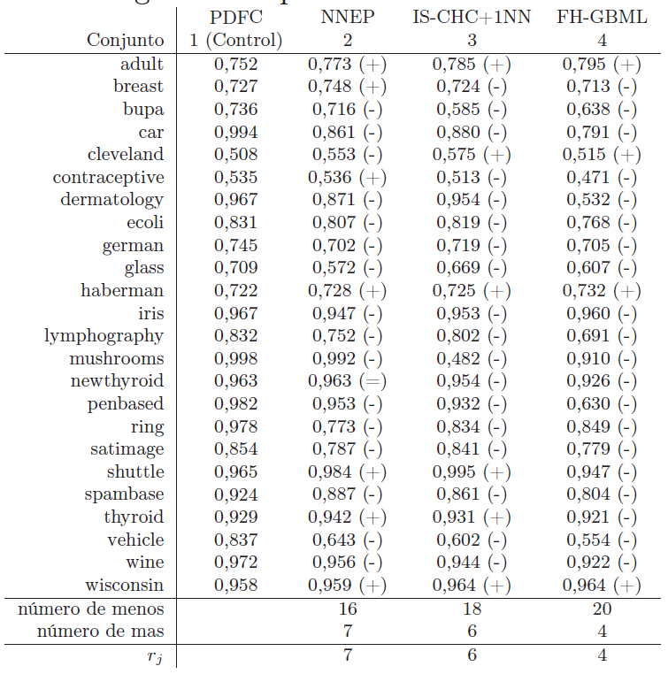
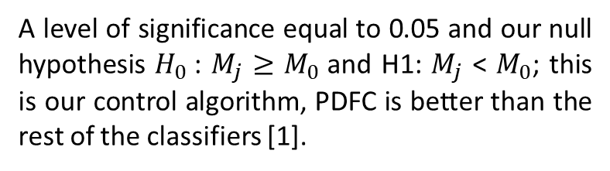
Tests
Development
Multiples Signs
Table 2: Comparison considering hit rate with PDFC as control method. The signs in parenthesis are used in the calculation of the Multiple Signs Test
The following procedure allows us to directly compare a set of method with a control method labeled 1. Follow the steps below to prove the null hypothesis:
A level of significance equal to 0.05 and our null hypothesis $H_{0}$: $M_{j}$ $≥$ $M_{0}$and H1: $M_{j}$ < $M_{0}$; this is our control algorithm, PDFC is better than the rest of the classifiers [1].
Universidade Federal do Espírito Santo
Artificial Intelligence Applied to Images
Deep ANNs applied to images

Slide 12
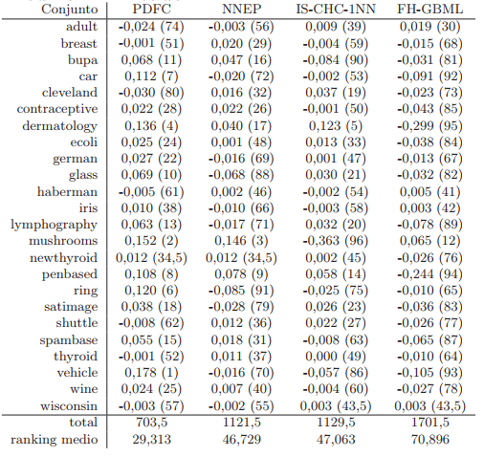
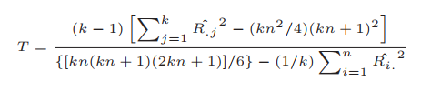
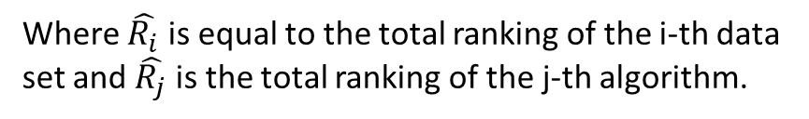
Tests
Development
Aligned Friedman Test
Table 3: Aligned observations of the 4 algorithms considered. considered. The rankings in parentheses are those used in the calculation of the Aligned Friedman test.
The Friedman test is based on n sets of rankings, one set for each data relation in our case; and the performances of the analyzed algorithms are ordered separately for each data set. Such a scheme allows for intra-set comparisons, since inter-set comparisons are not significant [1].
The Aligned Friedman test can be written as:
Where $\hat{R_{i}}$is equal to the total ranking of the i-th data set and $\hat{R_{j}}$ is the total ranking of the j-th algorithm.
Universidade Federal do Espírito Santo
Artificial Intelligence Applied to Images
Deep ANNs applied to images

Slide 13
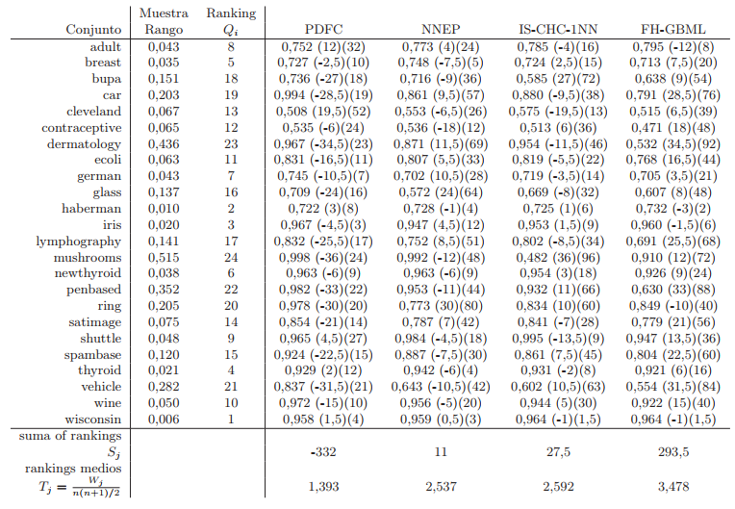
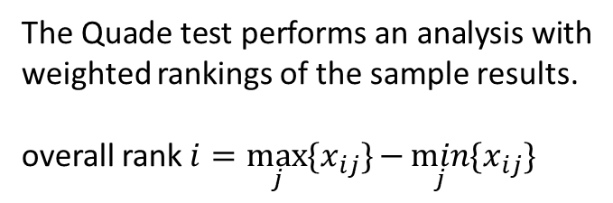
Tests
Development
Quade test
Table 4: Hit rate comparison for the 4 algorithms considered in our study. The rankings in parentheses are used in the calculation of the Quade test.
The Quade test performs an analysis with weighted rankings of the sample results.
overall rank $i=\max_{j}{{\{x}_{ij}\}}{−\min_{j}{{\{x}_{ij}\}}}$
Universidade Federal do Espírito Santo
Artificial Intelligence Applied to Images
Deep ANNs applied to images

Slide 14
CONCLUSION
After proceedings
Universidade Federal do Espírito Santo
Artificial Intelligence Applied to Images
Deep ANNs applied to images

Slide 15
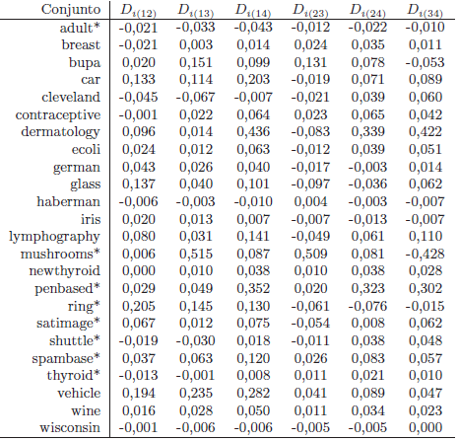
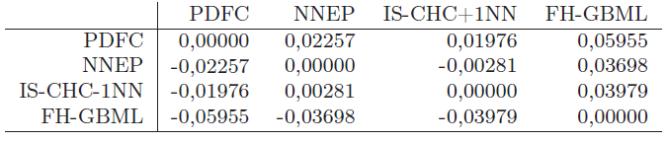
Conclusion
After proceedings
Income differences
Table 6: Differences between pairs of for each data set for each pair of algorithms for each pair of algorithms
They assumed that each performance measure is reflected as differences between algorithm performances. Consequently, they were interested in estimating the contrast between the sample performance medians considering all pairwise comparisons [1].
Table 7: Contrast estimation based on medians between all algorithms in the experimental study experimental study
Universidade Federal do Espírito Santo
Artificial Intelligence Applied to Images
Deep ANNs applied to images

Slide 16
REFERENCES
Bibliography Analysis: Un Tutorial Metodológico para hacer Comparaciones Estadísticas con Tests No Paramétricos en Propuestas de Minería de Datos
[1] GARCÍA Salvador; DERRAC, Joaquín; HERRERA, Francisco. Un Tutorial Metodológico para hacer Comparaciones Estadísticas con Tests No Paramétricos en Propuestas de Minería de Datos.
[2] SHESKIN, D.J., Handbook of Parametric and Nonparametric Statistical Procedures, Chapman & Hall/CRC, 2006.
[3] MINITAB STATISTICAL SOFTWARE. Sobre as hipóteses nula e alternativa. Disponível em: <https://support.minitab.com/pt-br/minitab/20/help-and-how-to/statistics/basic-statistics/supporting-topics/basics/null-and-alternative-hypotheses/#:~:text=A%20hip>. Acesso em: 27 ago. 2021.
Eduardo Destefani Stefanato¹*
Vitor Souza Premoli Pinto de Oliveira¹*
¹Universidade Federal do Espírito Santo
Artificial Intelligence Applied to Images
Universidade Federal do Espírito Santo
Artificial Intelligence Applied to Images
Deep ANNs applied to images

